Slide 1

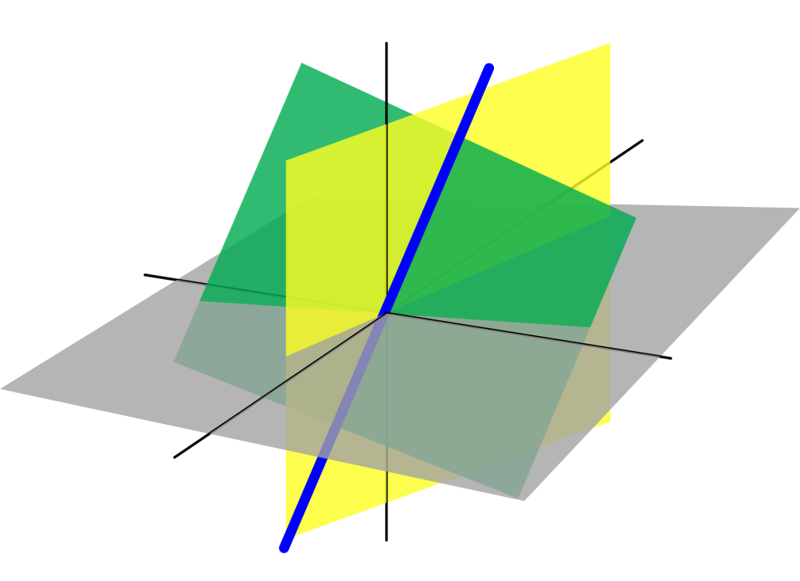
Azərbaycan Dövlət Neft və Sənaye Universiteti
Analytic Geometry

Slide 2
Vector Spaces:
Vectors in the Plane

Slide 3
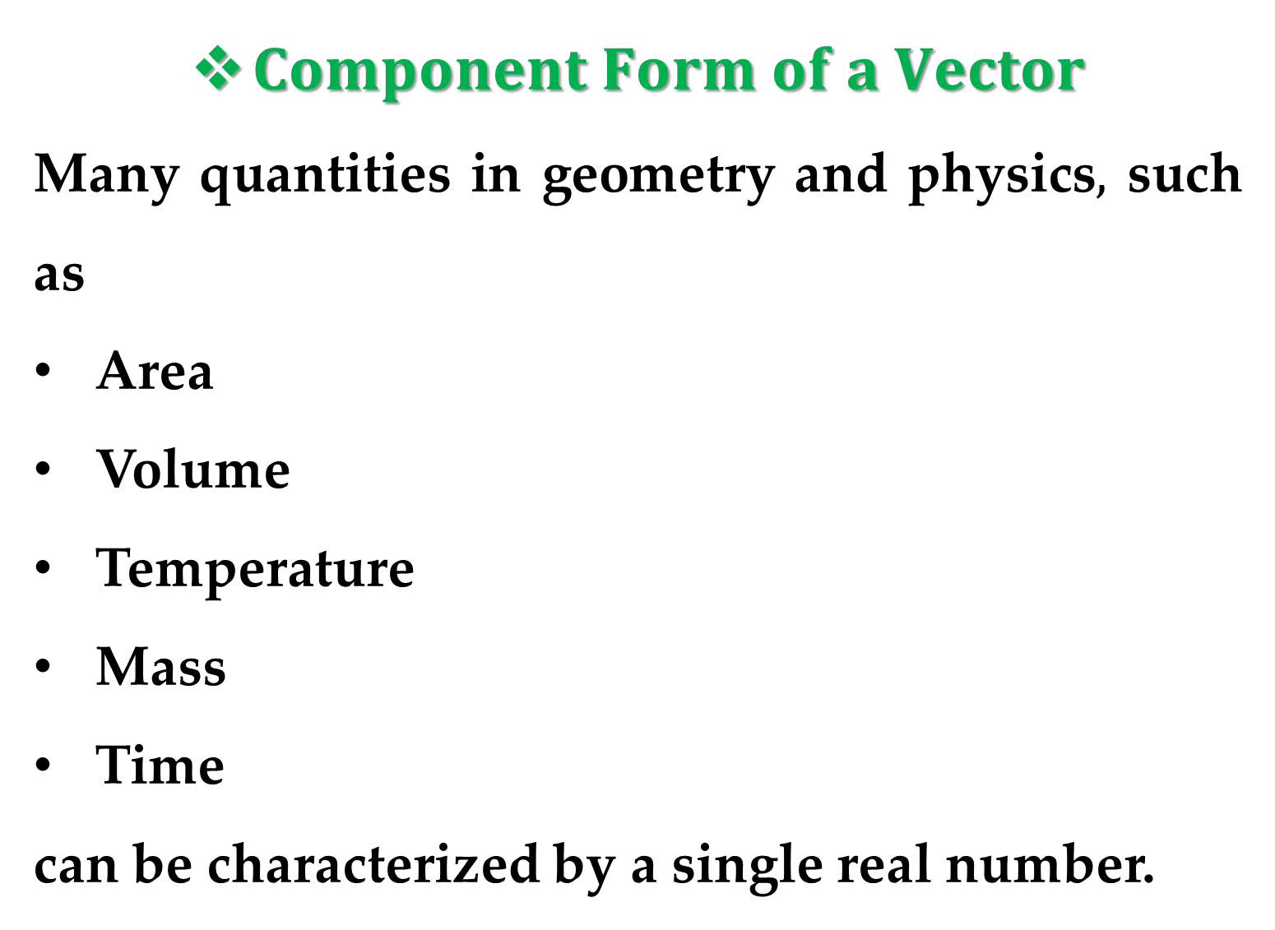
$Component Form of a Vector$
Many quantities in geometry and physics$,$ such as
Area
Volume
Temperature
Mass
Time
can be characterized by a single real number.

Slide 4
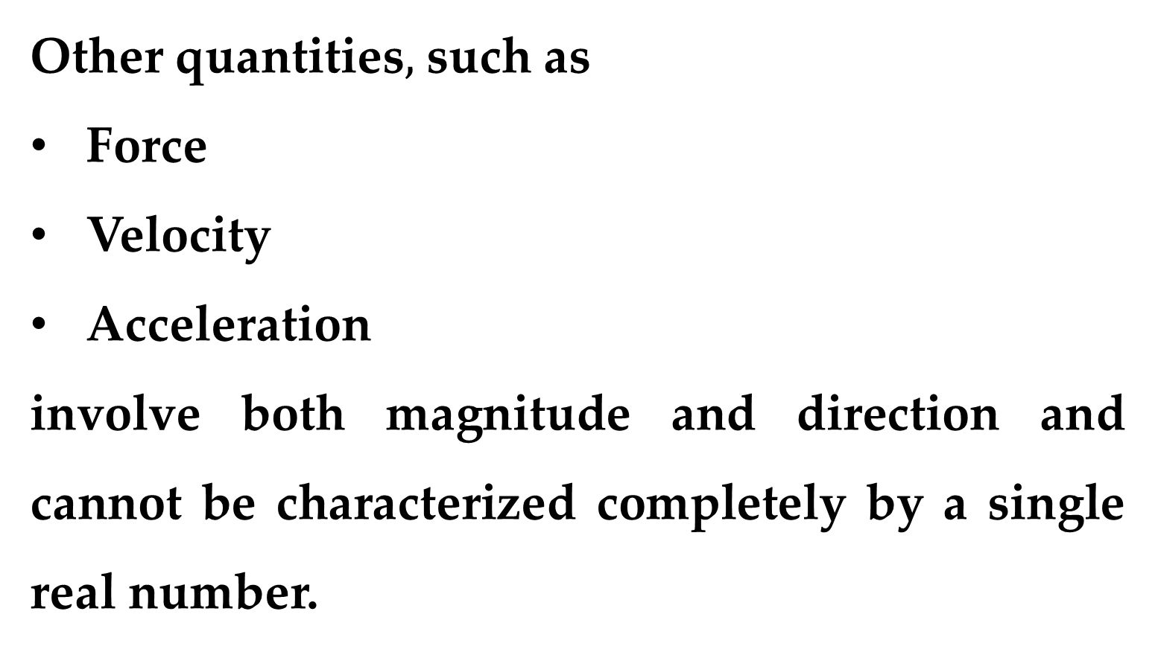
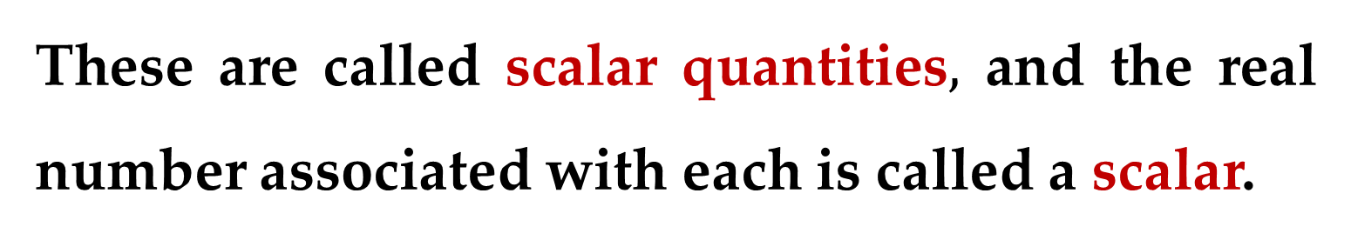
These are called scalar quantities$,$ and the real number associated with each is called a scalar.
Other quantities$,$ such as
Force
Velocity
Acceleration
involve both magnitude and direction and cannot be characterized completely by a single real number.

Slide 5
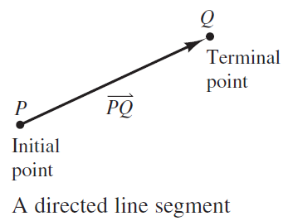
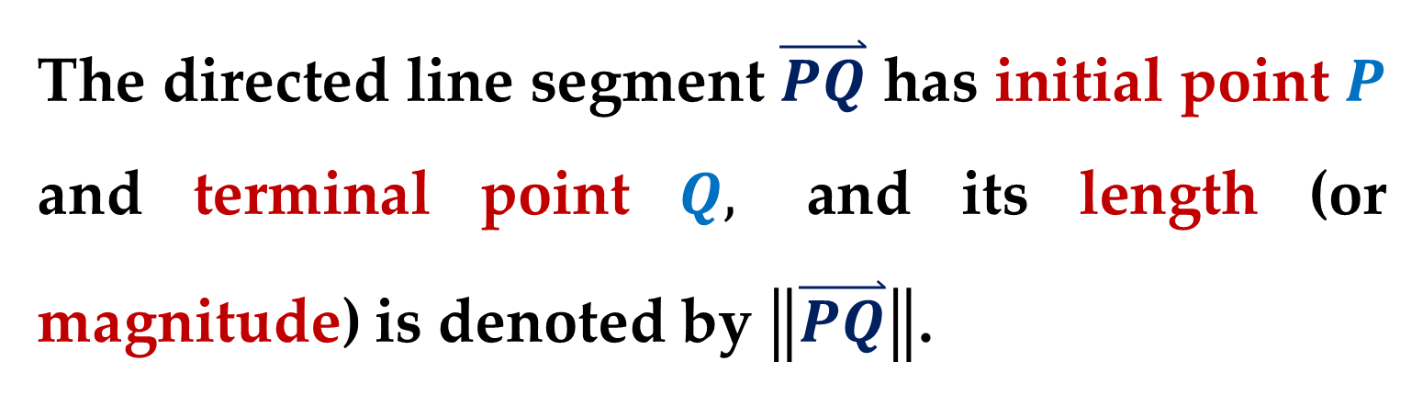
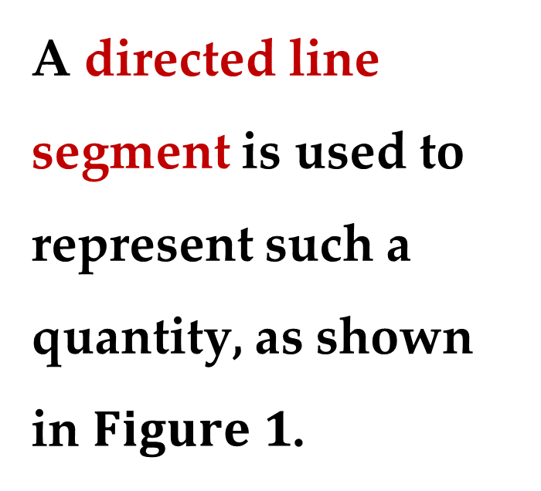
A directed line segment is used to represent such a quantity, as shown in $Figure 1$.
The directed line segment $\overset{⃑}{PQ}$ has initial point $P$ and terminal point $Q,$ and its length (or magnitude) is denoted by $\left\|\overset{⃑}{PQ}\right\|$.

Slide 6
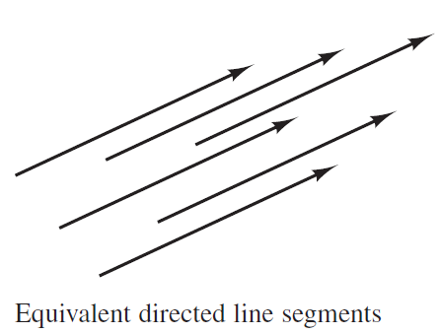
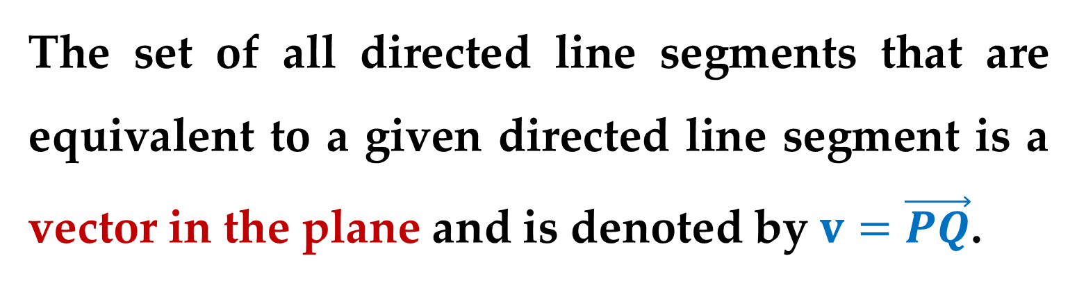
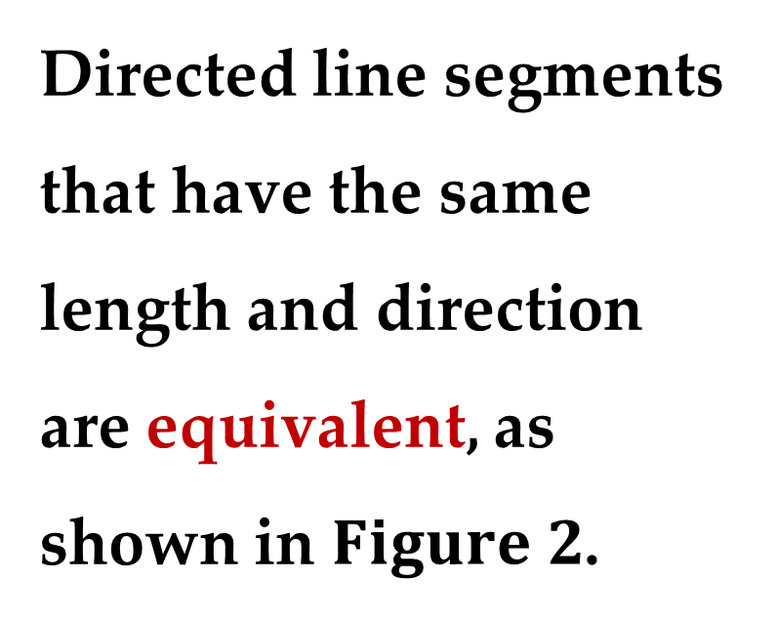
Directed line segments that have the same length and direction are equivalent, as shown in $Figure 2$.
The set of all directed line segments that are equivalent to a given directed line segment is a vector in the plane and is denoted by $v=\vec{PQ}$.

Slide 7
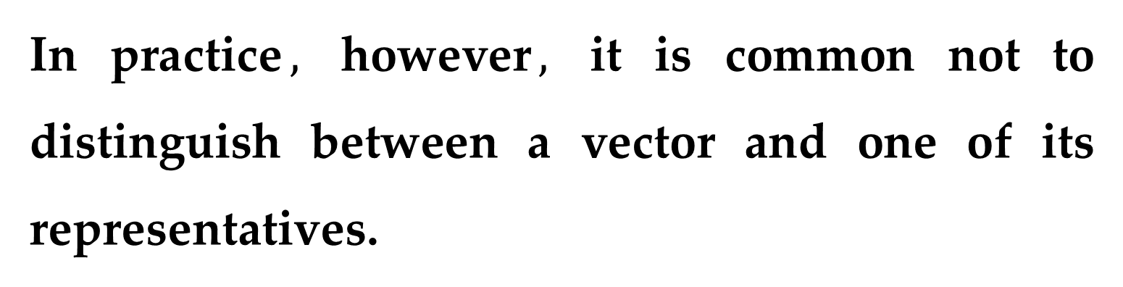
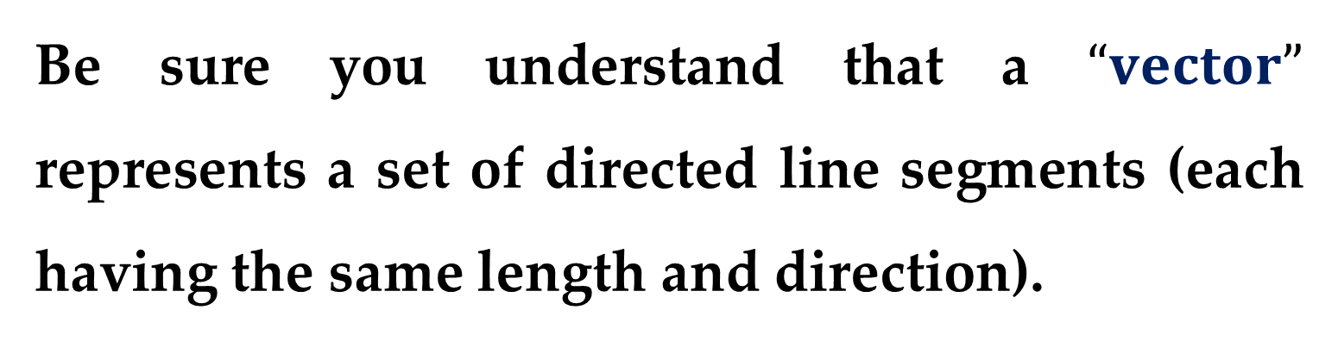
Be sure you understand that a $“vector”$ represents a set of directed line segments (each having the same length and direction).
In practice$,$ however$,$ it is common not to distinguish between a vector and one of its representatives.

Slide 8

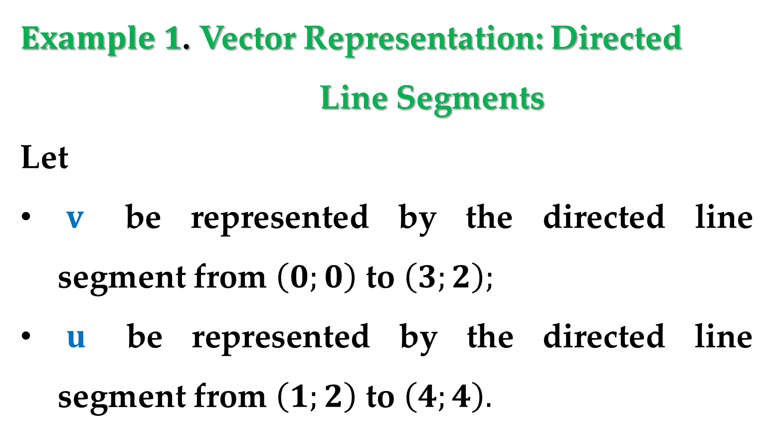
$Example 1$. Vector Representation: Directed Line Segments
Let
$v$ be represented by the directed line segment from $\left(0;0\right)$ to $\left(3;2\right);$
$u$ be represented by the directed line segment from $\left(1;2\right)$ to $\left(4;4\right).$
Show that $v$ and $u$ are equivalent.

Slide 9
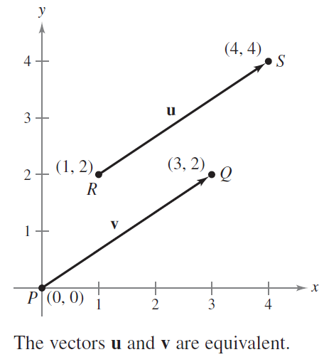
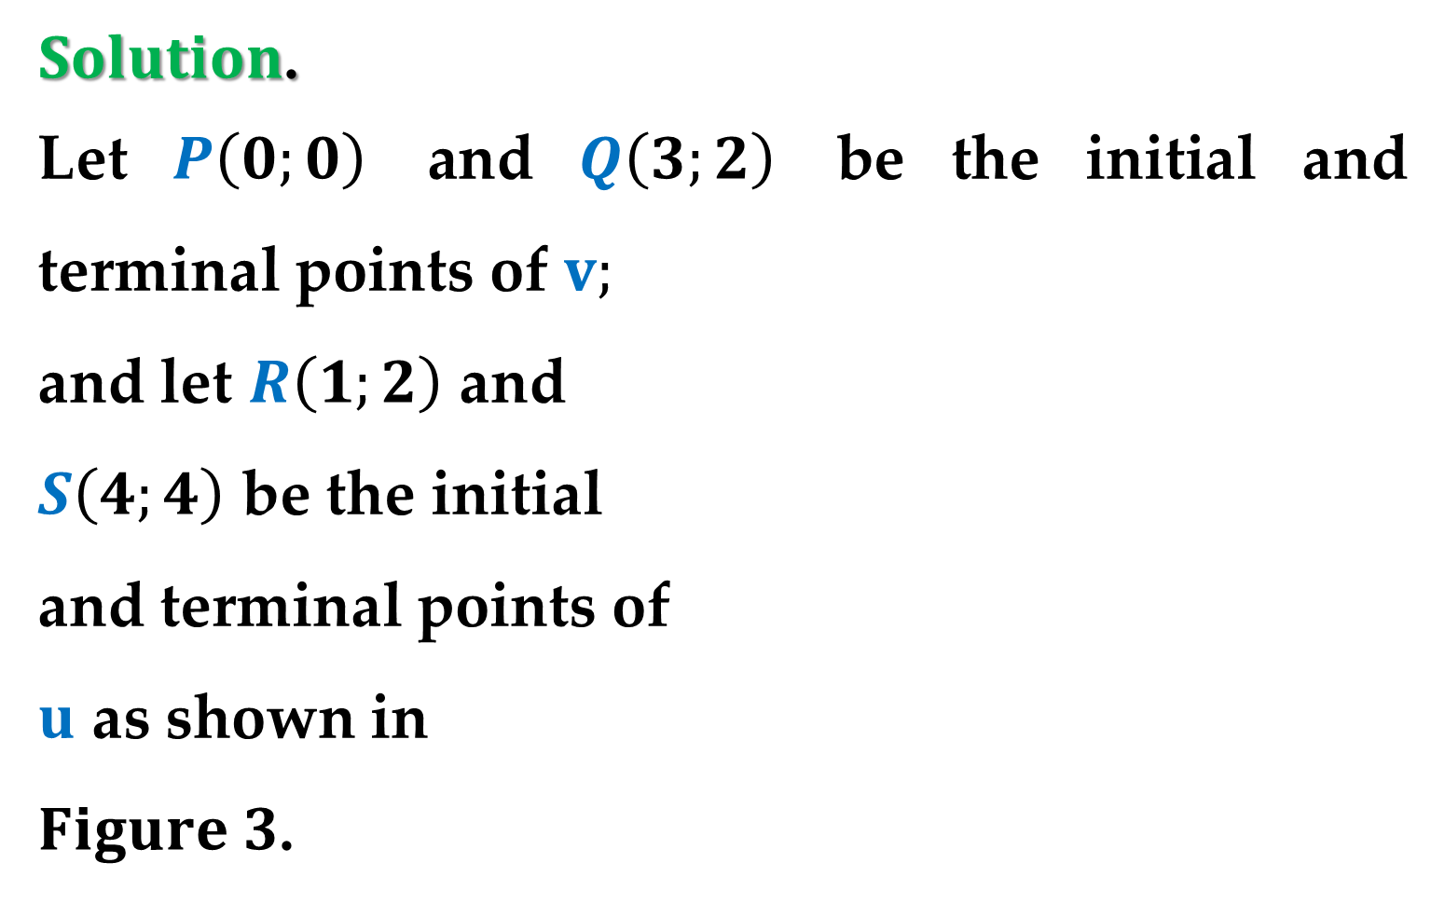
$Solution$.
Let $P\left(0;0\right)$ and $Q\left(3;2\right)$ be the initial and terminal points of $v;$
and let $R\left(1;2\right)$ and
$S\left(4;4\right)$ be the initial
and terminal points of
$u$ as shown in
$Figure 3$.

Slide 10
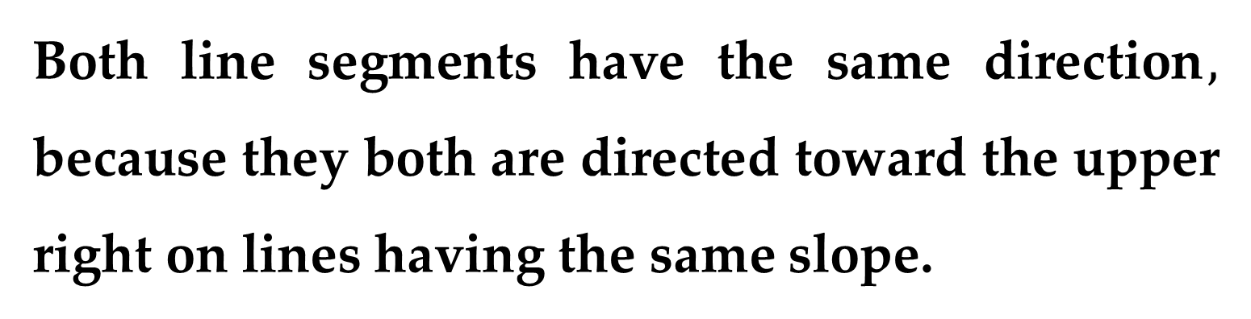
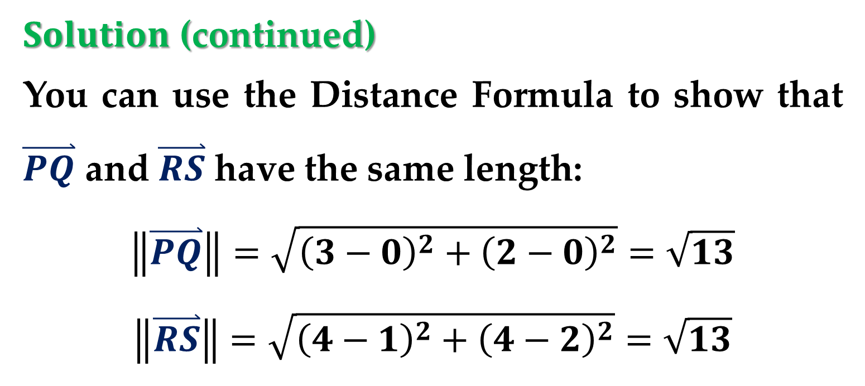
$Solution$ (continued)
You can use the Distance Formula to show that $\overset{⃑}{PQ}$ and $\overset{⃑}{RS}$ have the same length:
$$\left\|\overset{⃑}{PQ}\right\|=\sqrt{{\left(3−0\right)}^{2}+{\left(2−0\right)}^{2}}=\sqrt{13}$$
$$\left\|\overset{⃑}{RS}\right\|=\sqrt{{\left(4−1\right)}^{2}+{\left(4−2\right)}^{2}}=\sqrt{13}$$
Both line segments have the same direction$,$ because they both are directed toward the upper right on lines having the same slope.

Slide 11
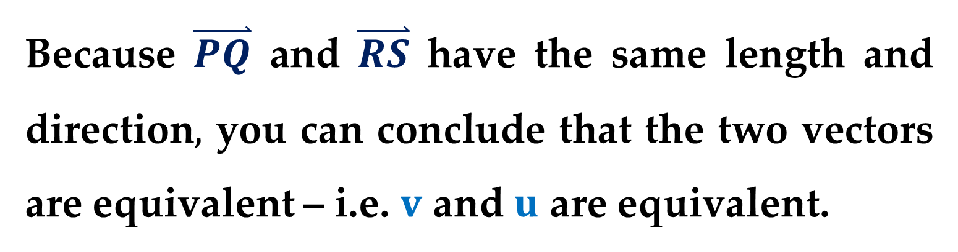
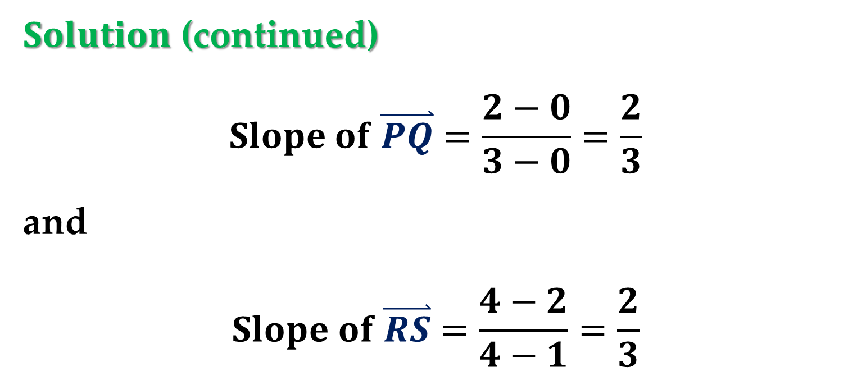
$Solution$ (continued)
$$Slope of \overset{⃑}{PQ}=\frac{2−0}{3−0}=\frac{2}{3}$$
and
$$Slope of \overset{⃑}{RS}=\frac{4−2}{4−1}=\frac{2}{3}$$
Because $\overset{⃑}{PQ}$ and $\overset{⃑}{RS}$ have the same length and direction$,$ you can conclude that the two vectors are equivalent – i.e. $v$ and $u$ are equivalent.

Slide 12
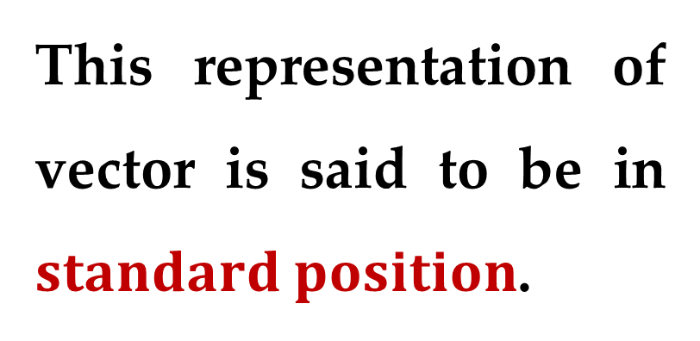
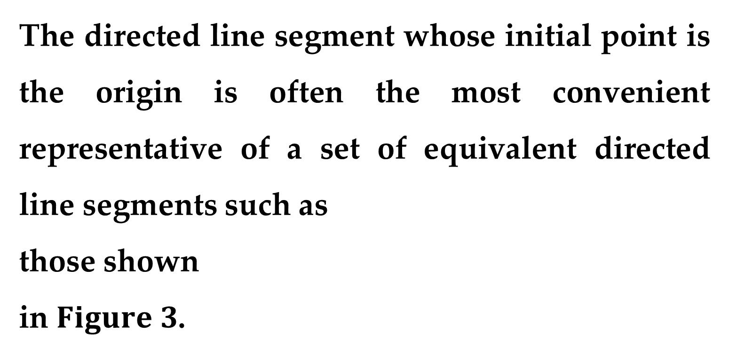
The directed line segment whose initial point is the origin is often the most convenient representative of a set of equivalent directed line segments such as
those shown
in $Figure 3$.
This representation of vector is said to be in $standard position$.

Slide 13
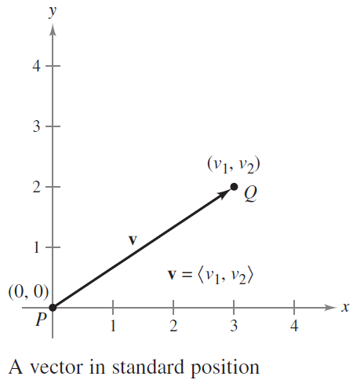
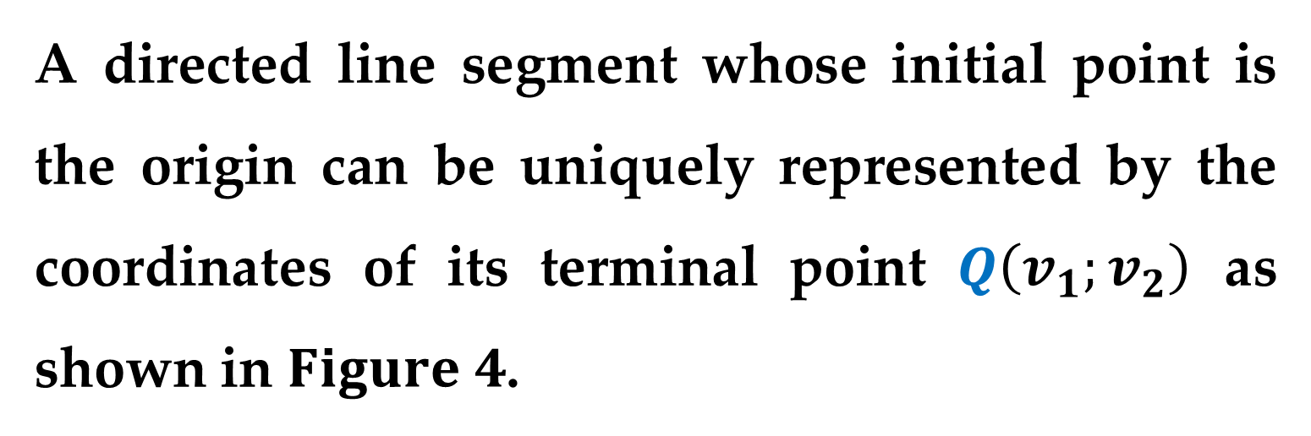
A directed line segment whose initial point is the origin can be uniquely represented by the coordinates of its terminal point $Q\left(v_{1};v_{2}\right)$ as shown in $Figure 4$.

Slide 14
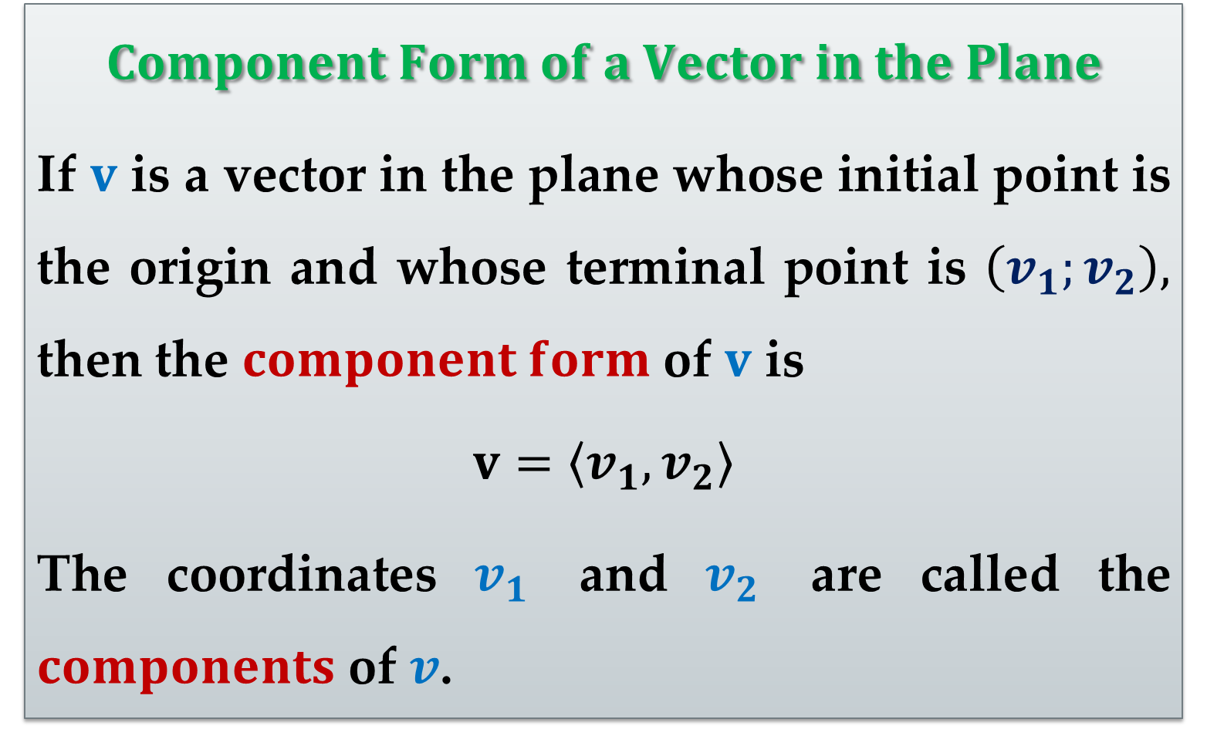
$$Component Form of a Vector in the Plane$$
If $v$ is a vector in the plane whose initial point is the origin and whose terminal point is $\left(v_{1};v_{2}\right),$ then the $component form$ of $v$ is
$$v=\left\langle v_{1},v_{2}\right\rangle$$
The coordinates $v_{1}$ and $v_{2}$ are called the $components$ of $v$.

Slide 15
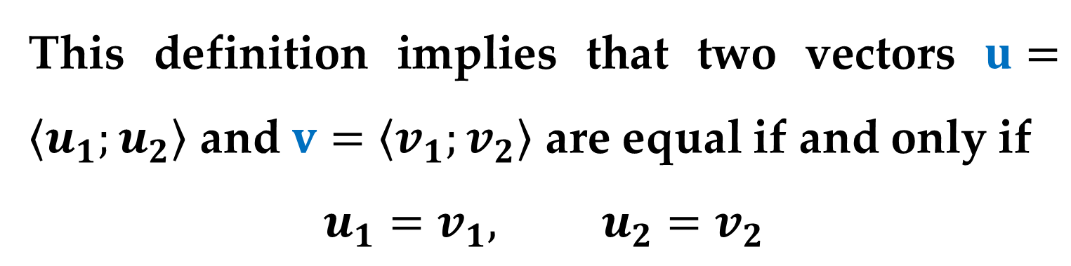
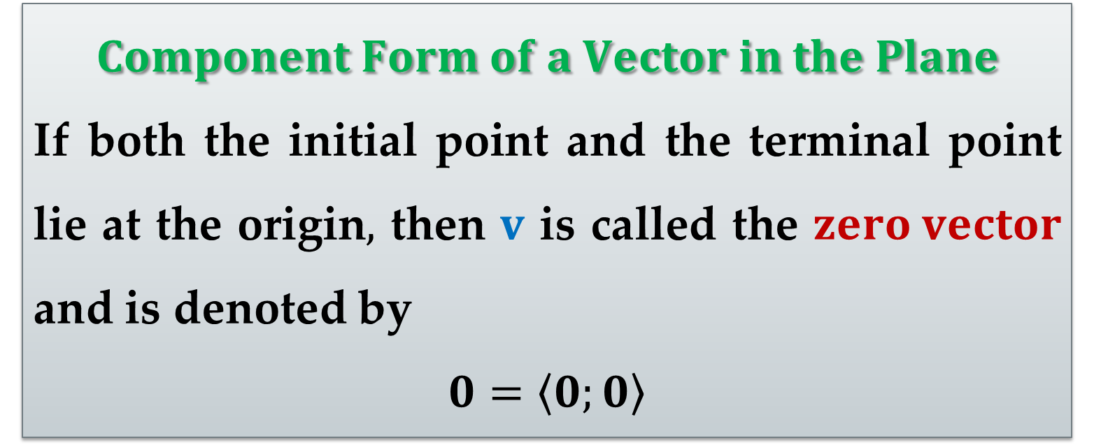
$$Component Form of a Vector in the Plane$$
If both the initial point and the terminal point lie at the origin$,$ then $v$ is called the $zero vector$ and is denoted by
$$0=\left\langle 0;0\right\rangle$$
This definition implies that two vectors $u=\left\langle u_{1};u_{2}\right\rangle$ and $v=\left\langle v_{1};v_{2}\right\rangle$ are equal if and only if
$$u_{1}=v_{1}, u_{2}=v_{2}$$

Slide 16
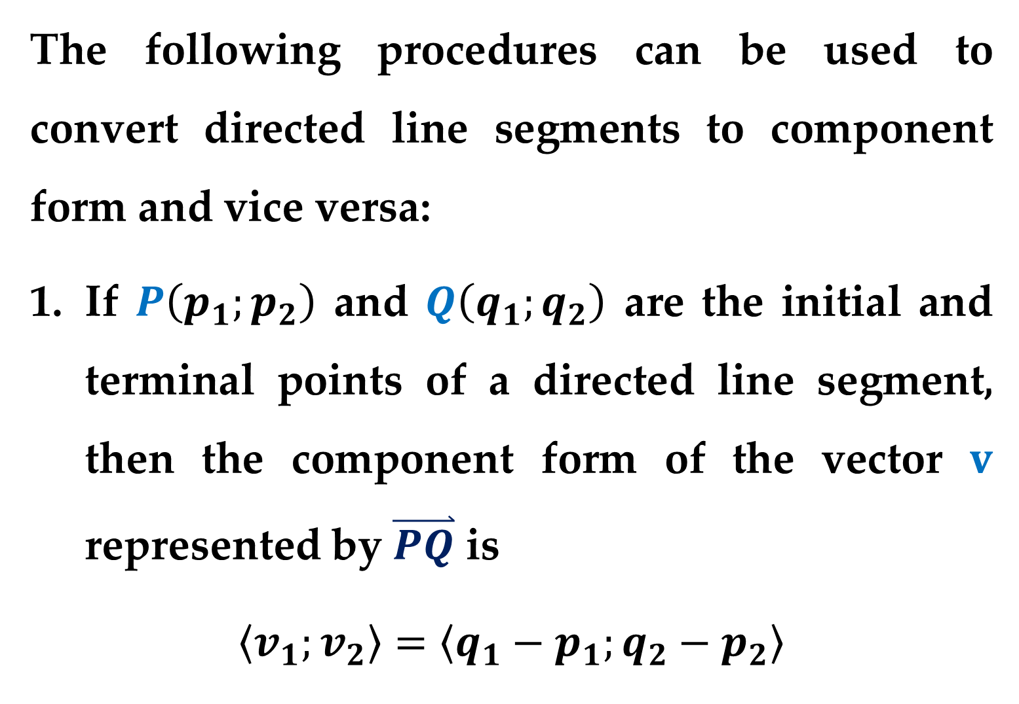
The following procedures can be used to convert directed line segments to component form and vice versa:
If $P\left(p_{1};p_{2}\right)$ and $Q\left(q_{1};q_{2}\right)$ are the initial and terminal points of a directed line segment, then the component form of the vector $v$ represented by $\overset{⃑}{PQ}$ is
$$\left\langle v_{1};v_{2}\right\rangle =\left\langle q_{1}−p_{1};q_{2}−p_{2}\right\rangle$$

Slide 17
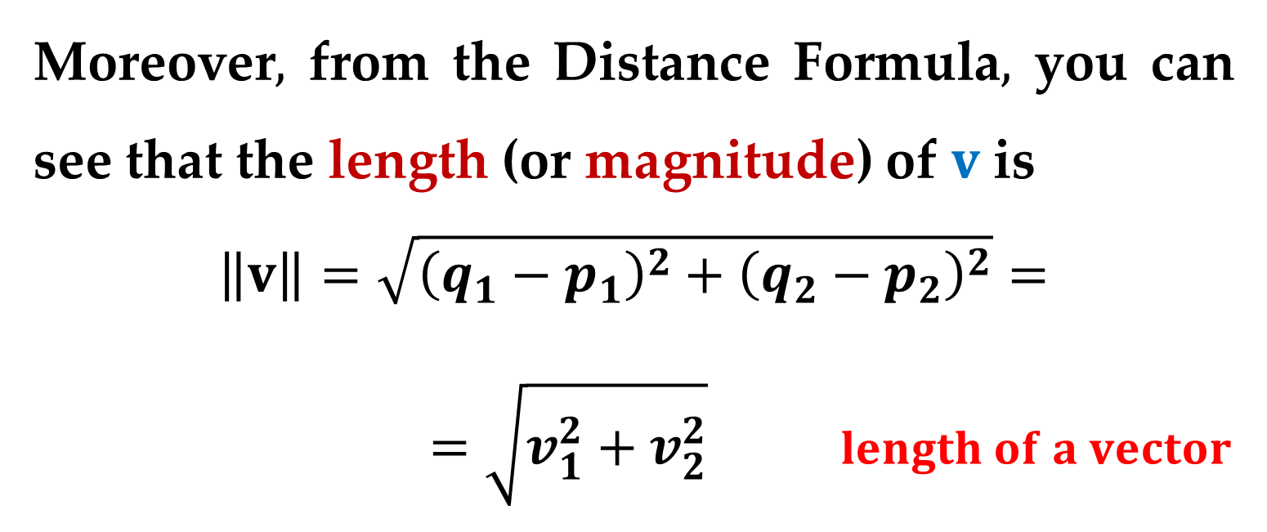
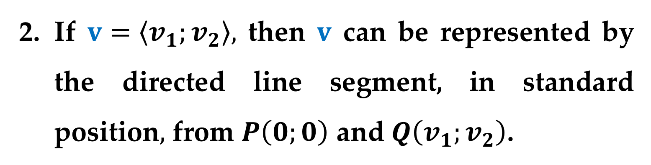
Moreover$,$ from the Distance Formula$,$ you can see that the length (or magnitude) of $v$ is
$$\left\|v\right\|=\sqrt{{\left(q_{1}−p_{1}\right)}^{2}+{\left(q_{2}−p_{2}\right)}^{2}}=$$
$$=\sqrt{v_{1}^{2}+v_{2}^{2}} length of a vector$$
If $v=\left\langle v_{1};v_{2}\right\rangle ,$ then $v$ can be represented by the directed line segment, in standard position$,$ from $P\left(0;0\right)$ and $Q\left(v_{1};v_{2}\right)$.

Slide 18
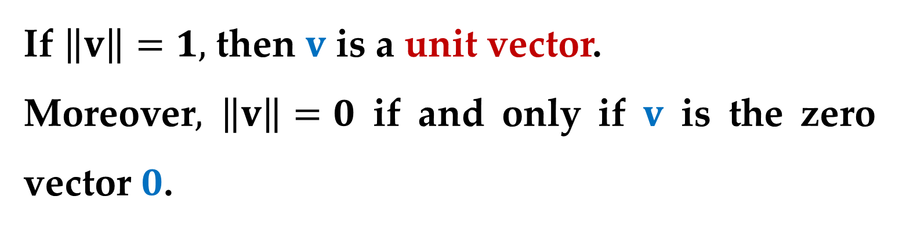

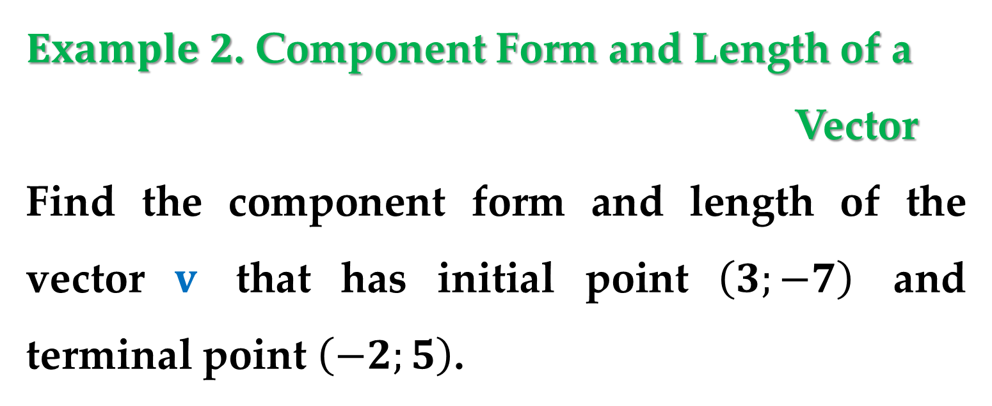
The length of $v$ is also called the norm of $v$.
If $\left\|v\right\|=1,$ then $v$ is a unit vector.
Moreover$,$ $\left\|v\right\|=0$ if and only if $v$ is the zero vector $0$.
$Example 2$. Component Form and Length of a
Vector
Find the component form and length of the vector $v$ that has initial point $\left(3;−7\right)$ and terminal point $\left(−2;5\right)$.

Slide 19
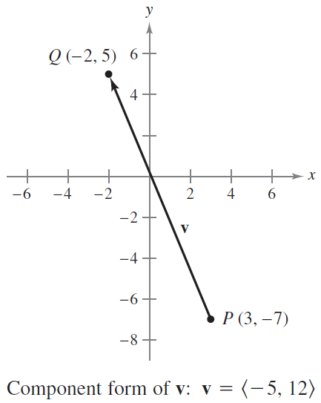
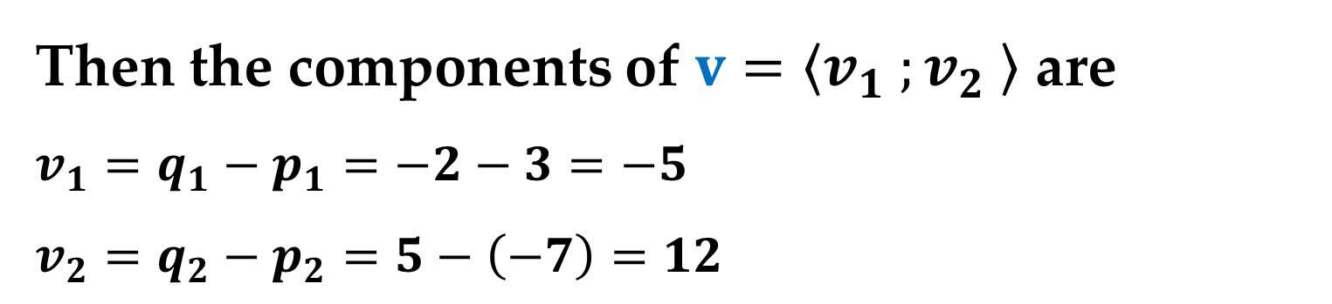
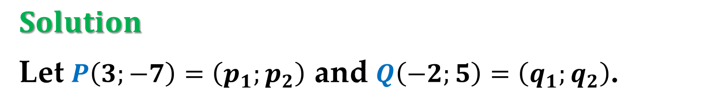
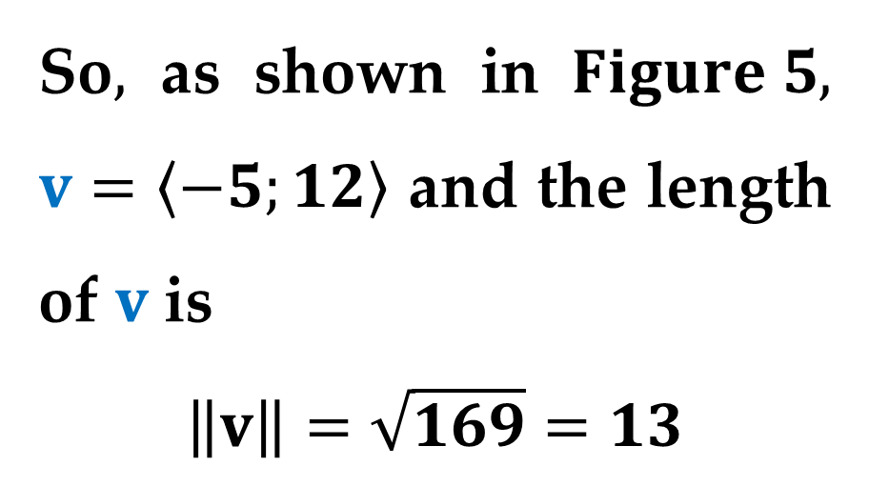
$Solution$
Let $P\left(3;−7\right)=\left(p_{1};p_{2}\right)$ and $Q\left(−2;5\right)=\left(q_{1};q_{2}\right)$.
Then the components of $v=\left\langle v_{1} ;v_{2} \right\rangle$ are
$v_{1}=q_{1}−p_{1}=−2−3=−5$
$v_{2}=q_{2}−p_{2}=5−\left(−7\right)=12$
So$,$ as shown in $Figure 5,$ $v=\left\langle −5;12\right\rangle$ and the length of $v$ is
$$\left\|v\right\|=\sqrt{169}=13$$

Slide 20
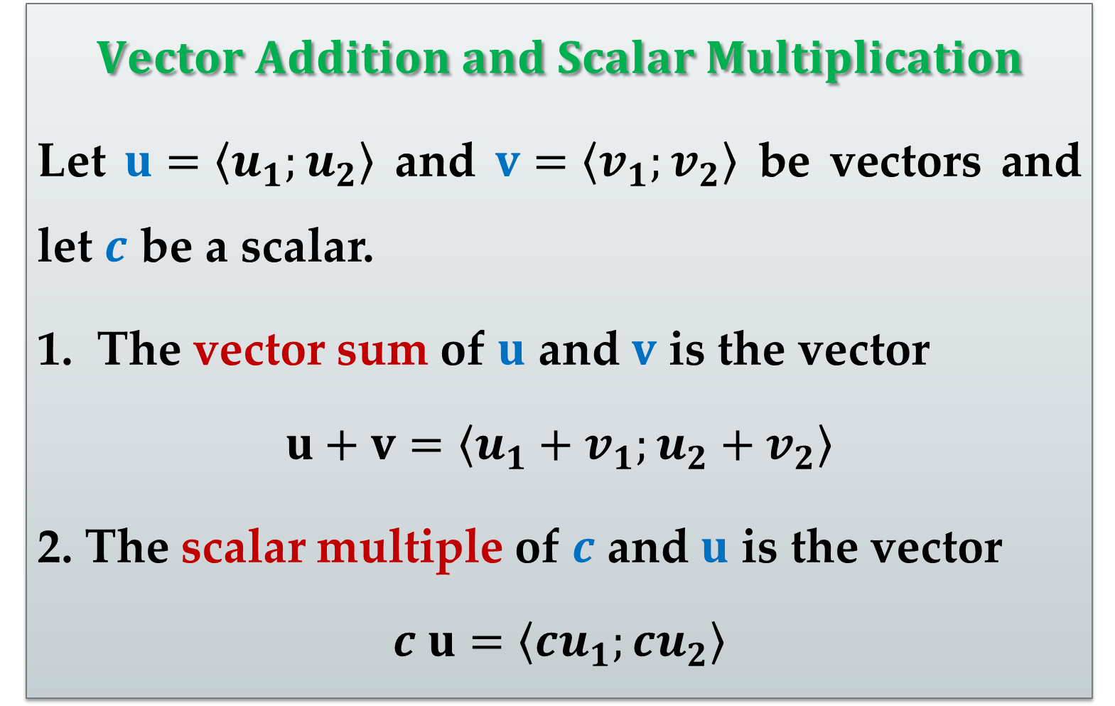
$Vector Operations$
$$Vector Addition and Scalar Multiplication$$
Let $u=\left\langle u_{1};u_{2}\right\rangle$ and $v=\left\langle v_{1};v_{2}\right\rangle$ be vectors and let $c$ be a scalar.
The vector sum of $u$ and $v$ is the vector
$$u+v=\left\langle u_{1}+v_{1};u_{2}+v_{2}\right\rangle$$
2. The scalar multiple of $c$ and $u$ is the vector
$$c u=\left\langle cu_{1};cu_{2}\right\rangle$$

Slide 21
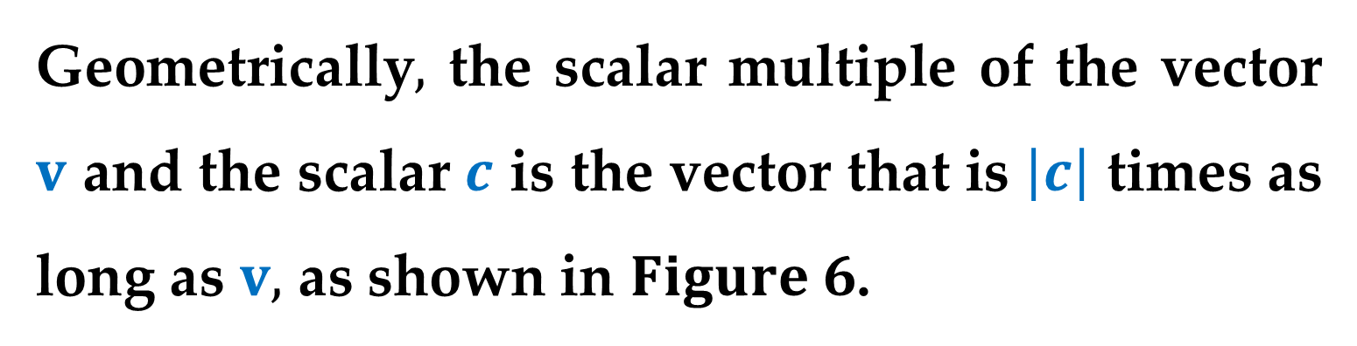
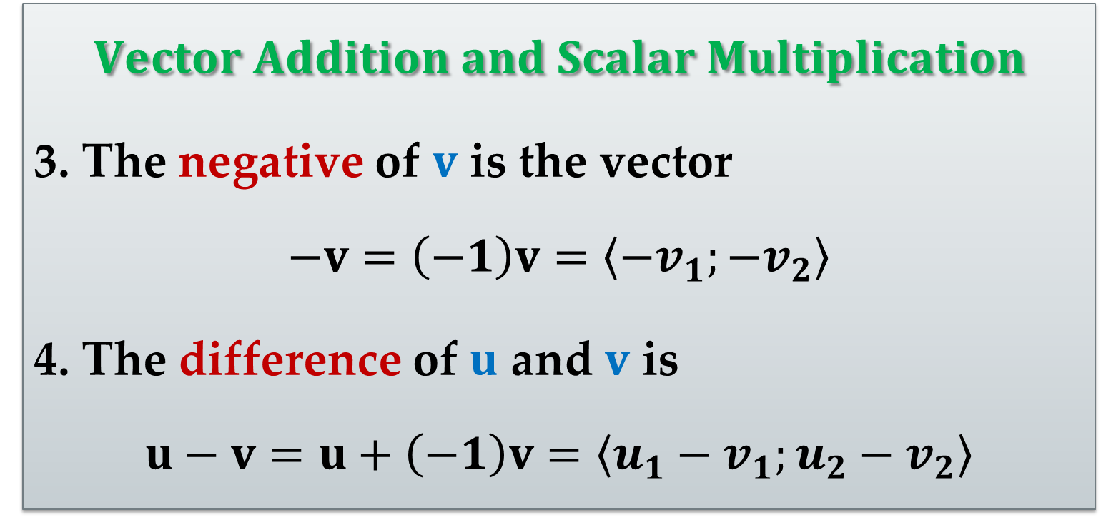
$$Vector Addition and Scalar Multiplication$$
3. The negative of $v$ is the vector
$$−v=\left(−1\right)v=\left\langle −v_{1};−v_{2}\right\rangle$$
4. The difference of $u$ and $v$ is
$$u−v=u+\left(−1\right)v=\left\langle u_{1}−v_{1};u_{2}−v_{2}\right\rangle$$
Geometrically$,$ the scalar multiple of the vector $v$ and the scalar $c$ is the vector that is $\left|c\right|$ times as long as $v,$ as shown in $Figure 6$.

Slide 22
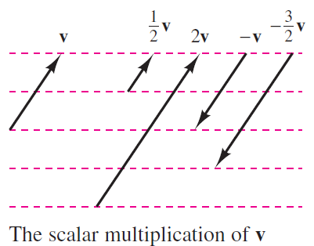
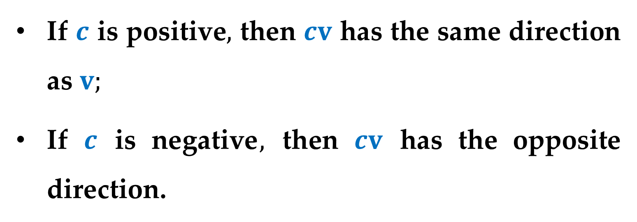
If $c$ is positive$,$ then $cv$ has the same direction as $v;$
If $c$ is negative$,$ then $cv$ has the opposite direction.

Slide 23
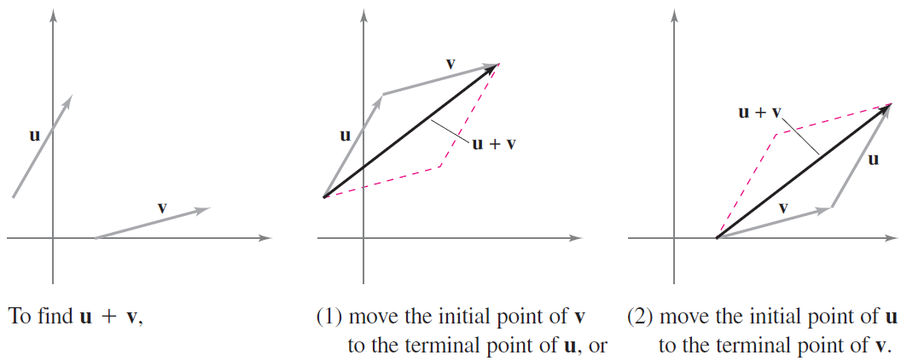
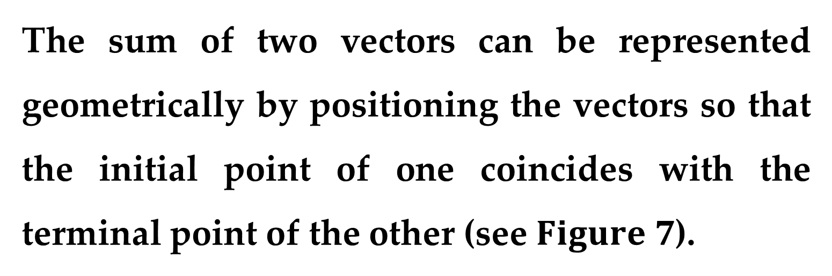
The sum of two vectors can be represented geometrically by positioning the vectors so that the initial point of one coincides with the terminal point of the other (see $Figure 7$).

Slide 24
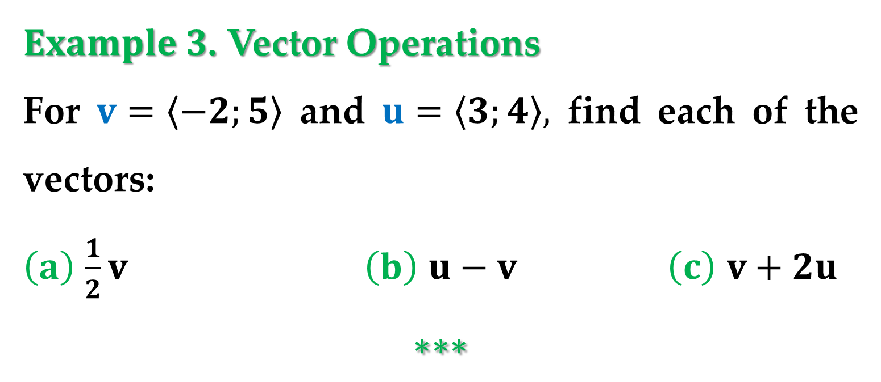
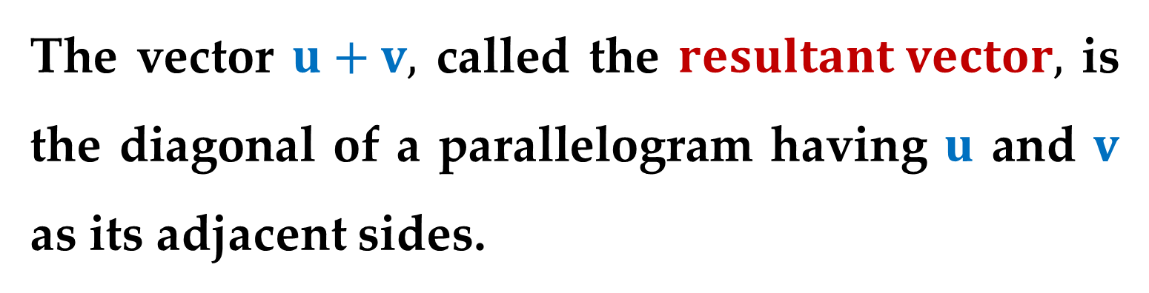
The vector $u+v,$ called the $resultant vector,$ is the diagonal of a parallelogram having $u$ and $v$ as its adjacent sides.
$Example 3$. Vector Operations
For $v=\left\langle −2;5\right\rangle$ and $u=\left\langle 3;4\right\rangle ,$ find each of the vectors:
$\left(a\right)$ $\frac{1}{2}v$ $\left(b\right)$ $u−v$ $\left(c\right)$ $v+2u$
$$∗∗∗$$

Slide 25
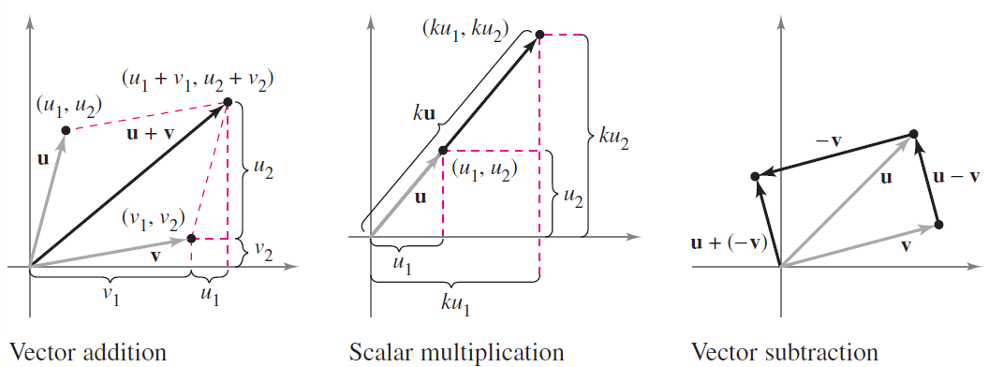
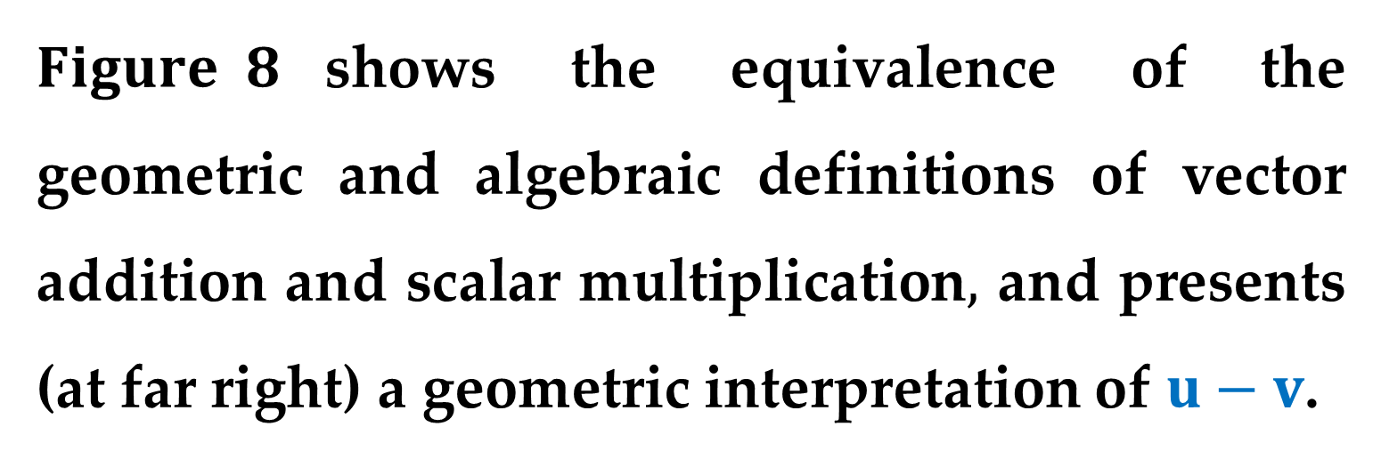
$Figure 8$shows the equivalence of the geometric and algebraic definitions of vector addition and scalar multiplication$,$ and presents (at far right) a geometric interpretation of $u−v$.

Slide 26
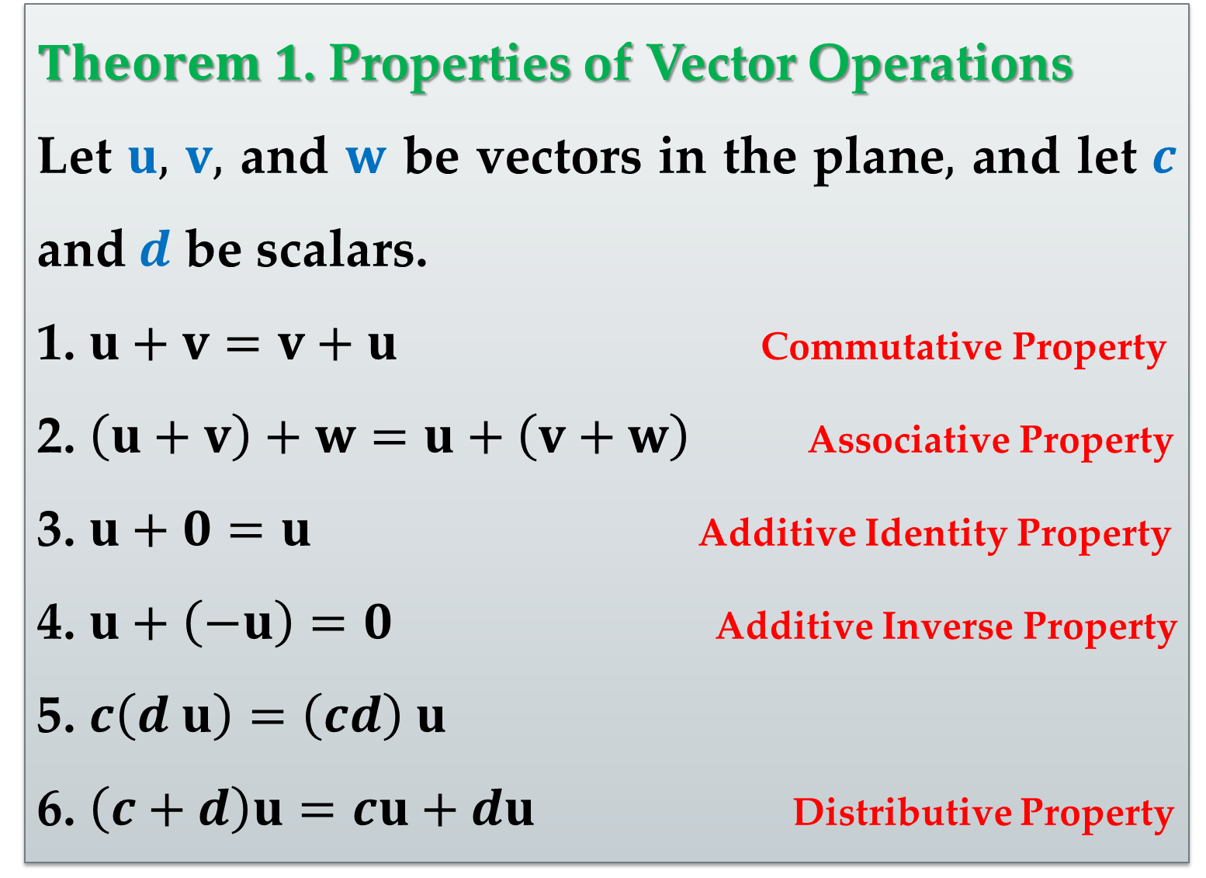
$Theorem 1$. Properties of Vector Operations
Let $u,$ $v,$ and $w$ be vectors in the plane$,$ and let $c$ and $d$ be scalars.
1. $u+v=v+u$ Commutative Property
2. $\left(u+v\right)+w=u+\left(v+w\right)$ Associative Property
3. $u+0=u$ Additive Identity Property
4. $u+\left(−u\right)=0$ Additive Inverse Property
5. $c\left(d u\right)=\left(cd\right) u$
6. $\left(c+d\right)u=cu+du$ Distributive Property

Slide 27
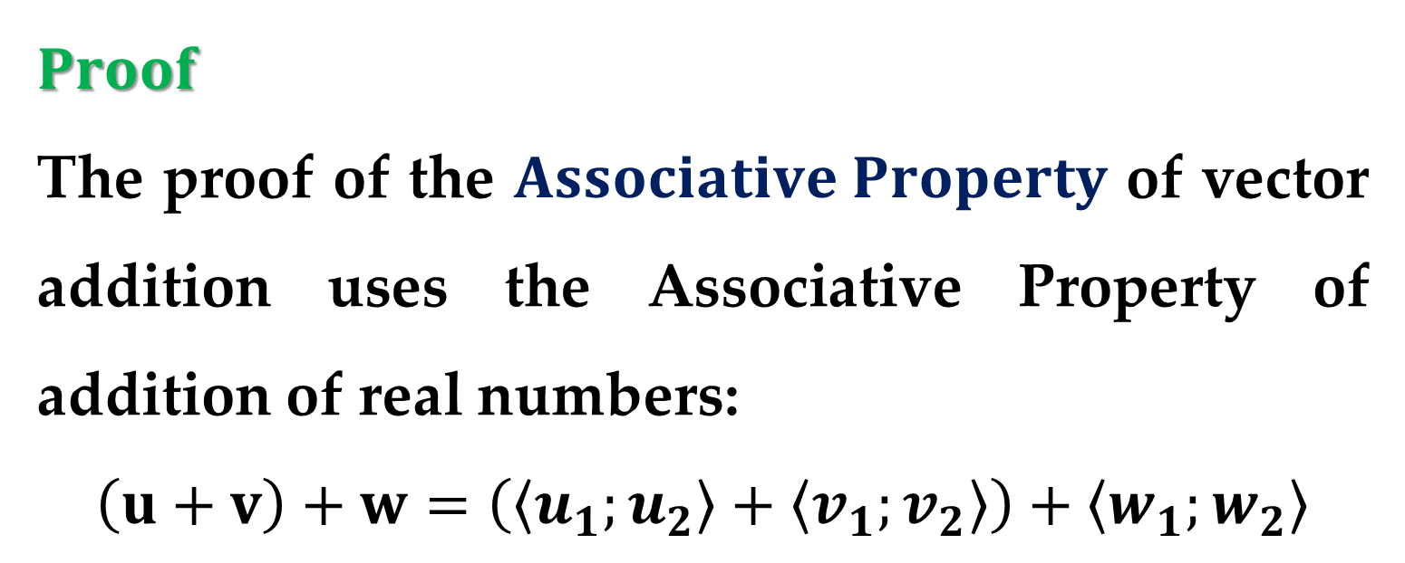
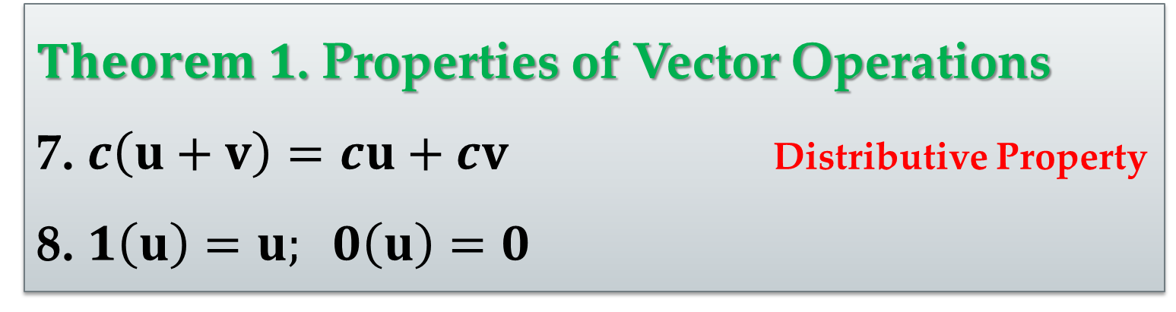
$Theorem 1$. Properties of Vector Operations
7. $c\left(u+v\right)=cu+cv$ Distributive Property
8. $1\left(u\right)=u; 0\left(u\right)=0$
$Proof$
The proof of the $Associative Property$ of vector addition uses the Associative Property of addition of real numbers:
$$\left(u+v\right)+w=\left(\left\langle u_{1};u_{2}\right\rangle +\left\langle v_{1};v_{2}\right\rangle \right)+\left\langle w_{1};w_{2}\right\rangle$$

Slide 28

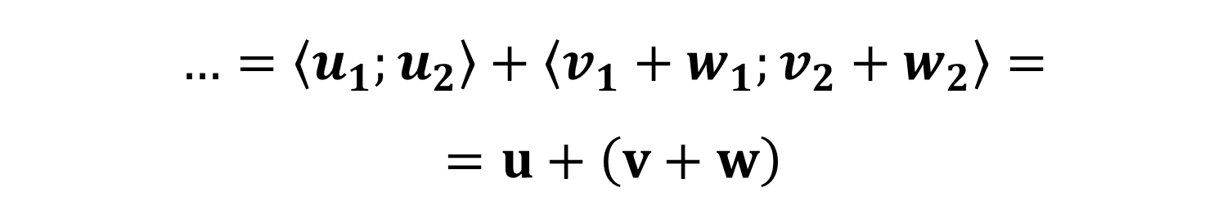
$Proof$ (continued)
$$…=\left\langle u_{1}+v_{1};u_{2}+v_{2}\right\rangle +\left\langle w_{1};w_{2}\right\rangle$$
$$…=\left\langle \left(u_{1}+v_{1}\right)+w_{1};\left(u_{2}+v_{2}\right)+w_{2}\right\rangle$$
$$…=\left\langle u_{1}+\left(v_{1}+w_{1}\right);u_{2}+\left(v_{2}+w_{2}\right)\right\rangle$$
$$…=\left\langle u_{1};u_{2}\right\rangle +\left\langle v_{1}+w_{1};v_{2}+w_{2}\right\rangle =$$
$$=u+\left(v+w\right)$$

Slide 29

$Proof$ (continued)
Similarly$,$ the proof of the Distributive Property of vectors depends on the Distributive Property of real numbers:
$$\left(c+d\right)u=\left(c+d\right)\left\langle u_{1};u_{2}\right\rangle$$
$$…=\left\langle \left(c+d\right)u_{1};\left(c+d\right)u_{2}\right\rangle$$
$$…=\left\langle cu_{1}+du_{1};cu_{2}+du_{2}\right\rangle$$
$$…=\left\langle cu_{1};cu_{2}\right\rangle +\left\langle du_{1};du_{2}\right\rangle =cu+du$$

Slide 30



$Proof$ (continued)
The other properties can be proved in a similar manner.
Any set of vectors (with an accompanying set of scalars) that satisfies the eight properties listed in $Theorem 1$ constitutes a $vector space$.
The eight properties listed above are the $vector space axioms$.

Slide 31


So$,$ this theorem states that the set of vectors in the plane (with the set of real numbers as scalars) forms a vector space.
$Theorem 2$. Length of a Scalar Multiple
Let $v$ be a vector and let $c$ be a scalar.
Then
$$\left\|c v\right\|=\left|c\right|\left\|v\right\|$$
$\left|c\right|$ is the absolute value of c.

Slide 32



$Proof$
Because $cv=\left\langle cv_{1};cv_{2}\right\rangle ,$ it follows that
$$\left\|c v\right\|=\left\|\left\langle cv_{1};cv_{2}\right\rangle \right\|=\sqrt{{\left(cv_{1}\right)}^{2}+{\left(cv_{2}\right)}^{2}}$$
$$…=\sqrt{c^{2}v_{1}^{2}+c^{2}v_{2}^{2}}=\sqrt{c^{2}\left(v_{1}^{2}+v_{2}^{2}\right)}$$
$$…=\left|c\right|\sqrt{v_{1}^{2}+v_{2}^{2}}=\left|c\right|\left\|v\right\|$$

Slide 33


In many applications of vectors$,$ it is useful to find a unit vector that has the same direction as a given vector.
$Theorem 3$. Unit Vector in the Direction of $v$
If $v$ is a nonzero vector in the plane$,$ then the vector
$$u=\frac{v}{\left\|v\right\|}=\frac{1}{\left\|v\right\|}v$$
has length $1$ and the same direction as $v$.

Slide 34



$Proof$
Because $\frac{1}{\left\|v\right\|}$ is positive and $u=\left(\frac{1}{\left\|v\right\|}\right)v,$ you can conclude that $u$ has the same direction as $v$.
To see that $\left\|u\right\|=1,$ note that
$$\left\|u\right\|=\left\|\left(\frac{1}{\left\|v\right\|}\right)v\right\|=\left|\frac{1}{\left\|v\right\|}\right|\left\|v\right\|=\frac{\left\|v\right\|}{\left\|v\right\|}=1$$
So$,$ $u$ has length $1$ and the same direction as $v$.

Slide 35



In $Theorem 3,$ $u$ is called a unit vector in the direction of $v$.
The process of multiplying $v$ by $1/\left\|v\right\|$ to get a unit vector is called normalization of $v$.
$Example 4$. Finding a Unit Vector
Find a unit vector in the direction of $v=\left\langle −2;5\right\rangle$ and verify that it has length $1$.

Slide 36


$Solution$
From $Theorem 3,$ the unit vector in the direction of $v$ is
$$\frac{v}{\left\|v\right\|}=\frac{\left\langle −2;5\right\rangle }{\sqrt{{\left(−2\right)}^{2}+5^{2}}}=\frac{\left\langle −2;5\right\rangle }{\sqrt{29}}=\left\langle −\frac{2}{\sqrt{29}};\frac{5}{\sqrt{29}}\right\rangle$$
This vector has length $1,$ because
$$\sqrt{{\left(−\frac{2}{\sqrt{29}}\right)}^{2}+{\left(\frac{5}{\sqrt{29}}\right)}^{2}}=\sqrt{\frac{29}{29}}=1$$

Slide 37



Generally$,$ the length of the sum of two vectors is not equal to the sum of their lengths.
To see this$,$ consider the vectors $u$ and $v$ as shown in $Figure 9$.

Slide 38


With $u$ and $v$ as two sides of a triangle$,$ the length of the third side is $\left\|u+v\right\|,$ and
$$\left\|u+v\right\|≤\left\|u\right\|+\left\|v\right\|$$
Equality occurs only when the vectors $u$ and $v$ have the same direction.
This result is called the triangle inequality for vectors.

Slide 39


$Standard Unit Vectors$
The unit vectors $\left\langle 0;1\right\rangle$ and $\left\langle 1;0\right\rangle$ are called the standard unit vectors in the plane and are denoted by
$i=\left\langle 1;0\right\rangle and j=\left\langle 0;1\right\rangle$
as shown in $Figure 10$.

Slide 40



These vectors can be used to represent any vector uniquely$,$ as follows:
$$v=\left\langle v_{1};v_{2}\right\rangle =\left\langle v_{1};0\right\rangle +\left\langle 0;v_{2}\right\rangle =$$
$$=v_{1}\left\langle 1;0\right\rangle +v_{2}\left\langle 0;1\right\rangle =$$
$$=v_{1}i+v_{2}j$$
The vector $v=v_{1}i+v_{2}j$ is called a linear combination of $i$ and $j$.
The scalars $v_{1}$ and $v_{2}$ are called the horizontal and vertical components of $v$.

Slide 41


$Example 5$. Writing a Linear Combination of
Unit Vectors
Let $u$ be the vector with initial point $\left(2;−5\right)$ and terminal point $\left(−1;3\right),$ and let $v=2i−j$.
Write each vector as a linear combination of $i$ and $j$:
$\left(a\right)$ $u$ $\left(b\right)$ $w=2u−2v$

Slide 42

$Solution$
$\left(a\right)$ $u=\left\langle q_{1}−p_{1};q_{2}−p_{2}\right\rangle =\left\langle −1−2;3−\left(−5\right)\right\rangle$
$$…=\left\langle −3;8\right\rangle =−3i+8j$$
$\left(b\right)$ $w=2u−3v=2\left(−3i+8j\right)−2\left(2i−j\right)$
$$…=−6i+16j−4i+2j=−10i+18j$$

Slide 43


If $u$ is a unit vector and $θ$ is the angle (measured counterclockwise) from the positive $x−$axis to $u,$ then the terminal point of $u$ lies on the unit circle$,$ and you have
$u=\left\langle \cos{θ},\sin{θ}\right\rangle =$
$\cos{θ}i+\sin{θ}j$
as shown in $Figure 11$.

Slide 44

Moreover$,$ it follows that any other nonzero vector $v$ making an angle $θ$ with the positive $x−$axis has the same direction as $u$ and you can write
$$v=\left\|v\right\| \left\langle \cos{θ},\sin{θ}\right\rangle =$$
$$=\left(\left\|v\right\|\cos{θ}\right) i+\left(\left\|v\right\|\sin{θ}\right) j$$

Slide 45


$Example 6$. Writing a Vector of Given
Magnitude and Direction
The vector $v$ has a magnitude of $3$ and makes an angle of $30^{°}=\frac{π}{6}$ with the positive $x−$axis.
Write $v$ as a linear combination of the unit vectors $i$ and $j$.

Slide 46


$Solution$
Because the angle between $v$ and the positive $x−$axis is $θ=\frac{π}{6},$ you can write
$$v=\left(\left\|v\right\|\cos{θ}\right) i+\left(\left\|v\right\|\sin{θ}\right) j$$
$$v=3\cos{\frac{π}{6}}i+3\sin{\frac{π}{6}}j=\frac{3\sqrt{3}}{2}i+\frac{3}{2}j$$

Slide 47



Vectors have many applications in physics and engineering. One example is $force$.
A vector can be used to represent $force,$ because $force$ has both magnitude and direction.
If two or more forces are acting on an object$,$ then the $resultant force$ on the object is the vector sum of the vector forces.

Slide 48



$Example 7$. Finding the Resultant Force
Two tugboats are pushing an ocean liner$,$ as shown in $Figure 12$.
Each boat is exerting a force of $400$ pounds.
What is the resultant force on the ocean liner?

Slide 49


$Solution$
Using $Figure 12,$ you can represent the forces exerted by the first and second tugboats as
$$F_{1}=400\left\langle \cos{20^{°}},\sin{20^{°}}\right\rangle =$$
$$=\left(400\cos{20^{°}}\right) i+\left(400\sin{20^{°}}\right) j$$
$$F_{2}=400\left\langle \cos{−20^{°}},\sin{−20^{°}}\right\rangle =$$
$$=\left(400\cos{20^{°}}\right) i−\left(400\sin{20^{°}}\right) j$$

Slide 50



$Solution$ (continued)
The resultant force on the ocean liner is
$$F=F_{1}+F_{2}=\left[\left(400\cos{20^{°}}\right)i+\left(400\sin{20^{°}}\right)j \right]$$
$$+\left[\left(400\cos{20^{°}}\right)i−\left(400\sin{20^{°}}\right)j\right]$$
$$…=\left(800\cos{20^{°}}\right) i≈752i$$
So$,$ the resultant force on the ocean liner is approximately $752$ pounds in the direction of the positive $x−$axis.

Slide 51
In surveying and navigation, a bearing is a direction that measures the acute angle that a path or line of sight makes with a fixed north-south line.
In air navigation, bearings are measured in degrees clockwise from north.

Slide 52



$Example 8$. Finding a Velocity
An airplane is traveling at a fixed altitude with a negligible wind factor.
The airplane is traveling at a speed of $500$ miles per hour with a bearing of $330^{°}$.
$Figure$ $13(a)$.

Slide 53



$Example 8$. (continued)
As the airplane reaches a certain point$,$ it faces wind with a velocity of $70$ miles per hour in the direction N $45^{°}$ E.
What are the resultant speed and direction of the airplane?
$$Figure 13(b)$$

Slide 54


$Solution$.
Using $Figure 13(a),$ let$’$s represent the velocity of the airplane (alone) as
$$v_{p}=\left(500\cos{120^{°}}\right) i+\left(500\sin{120^{°}}\right) j$$
The velocity of the wind is represented by the vector
$$v_{w}=\left(70\cos{45^{°}}\right) i+\left(70\sin{45^{°}}\right) j$$

Slide 55

$Solution$. $\left(continued\right)$
The resultant velocity of the airplane (in the wind) is
$$v=v_{p}+v_{w}=$$
$$\left[\left(500\cos{120^{°}}\right) i+\left(500\sin{120^{°}}\right) j\right]+$$
$$+\left[\left(70\cos{45^{°}}\right) i+\left(70\sin{45^{°}}\right) j\right]$$
$$≈−200.5i+482.5j$$

Slide 56


$Solution$ (continued)
To find the resultant speed and direction$,$ write
$$v=\left\|v\right\|\left(\cos{θ}i+\sin{θ}j\right)$$
Because
$$\left\|v\right\|≈\sqrt{{\left(−200.5\right)}^{2}+{\left(482.5\right)}^{2}}≈522.5$$
you can write
$$v≈522.5\left(−\frac{200.5}{522.5}i+\frac{482.5}{522.5}j\right)$$

Slide 57


$Solution$ (continued)
$$v≈522.5\left[\cos{112.6^{°}i}+\sin{112.6^{°}}j\right]$$
The new speed of the airplane$,$ as altered by the wind$,$ is approximately $522.5$ miles per hour in a path that makes an angle of $112.6$ with the positive $x−$axis.

Slide 58
Thank you for attention

